Slide 1
“Cyprus-An International Health Centre”
Prof. Philippos C. Patsalis
Minister of Health
Republic of Cyprus

Slide 2
Presentation Structure
Introduction
Cyprus: Health Status of the Population
Cyprus: Health System and the current Reforms
Cyprus: Global Health Perspective
Cyprus : An International Medical Tourism Destination
Cyprus: Prospects and Opportunities for Medical Investments
Notes:
Please allow me to navigate through the structure of this presentation
Following an introduction, information on the Health Status of the population of Cyprus is going to be presented followed by an overview of our Health System as well as the various reforms we have recently embarked. The Global Health perspective of the country as well as its role as an international medical tourism destination will follow. The presentation will conclude with a brief reference on the prospects and opportunities for medical investments

Slide 3
A. Introduction

Slide 4
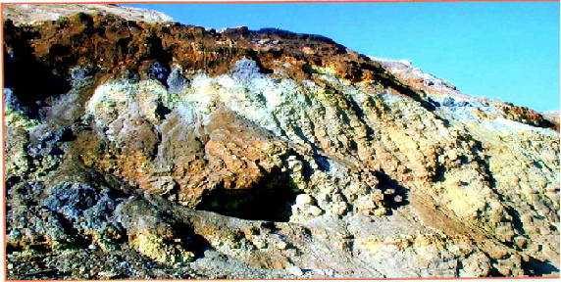
Since ancient years, Cyprus was famous for its vegetation as well as metals with healing effects. Aristoteles refers specifically to the Mountain Troodos as a place where these can be found
PHOTO page 16
Notes:
The history of medicines in Cyprus goes back for thousands of years.
Since ancient years, Cyprus was famous for its vegetation as well as metals with healing effects. Aristoteles refers specifically to the Mountain Troodos as a place where these can be found and used for medical and pharmaceutical purposes.

Slide 5
The geological morphology of Cyprus was formed by submarine volcanic activity in a deep ocean called Tethys some 90 Ma ago, resulting in the formation of many copper deposits.
The existence of copper mines enabled the production of metals from which basic ingredients were used for medical and pharmaceutical purposes.
One of the greatest mine copper is the Troodos' Mountain, which by unique and complicated geological procedures uplifted to its present elevation of 1952 m.
The impressive topography greatly affected the climatic conditions, increased considerably the precipitation and its water resources and produced a great variety of flora and fauna, as well as a thick cover of forest and made the island a very nice place for people to live.
Notes:
A main reason for the existence of such rich resources is the geological morphology of the country, which was formed by submarine volcanic activity in a deep ocean called Tethys some 90 Ma ago, resulting in the formation of many copper deposits.
The existence of copper mines enabled the production of metals from which basic ingredients were used for medical and pharmaceutical purposes.
One of the greatest mine copper is the Troodos' Mountain, which by unique and complicated geological procedures uplifted to its present elevation of 1952 m.
The impressive topography greatly affected the climatic conditions, increased considerably the precipitation and its water resources and produced a great variety of flora and fauna, as well as a thick cover of forest and made the island a very nice place for people to live.

Slide 6
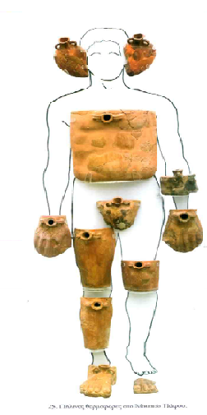
Cyprus has been known as a medical destination since ancient years.
Visitors came to Cyprus to be treated by Cypriot Doctors, such as Apollodoros of Kition, Synesis the Cypriot and Apollonios of Kition (1st century BC) who was also known as the Cypriot Hippocrates.
Notes:
Also, the various excavation findings and the existed literature indicates that Cyprus was known as a medical destination since ancient years.
Bibliography sets Cyprus as a destination for treatment reasons from people living abroad , by Cypriot Doctors such as Apollodoros of Kition, Synesis the Cypriot and Apollonios of Kition (1st century BC) who was also known as the Cypriot Hippocrates.
The picture in this slide can be considered as a characteristic one for the use of thermal bottles in various parts of the human body for therapeutic reasons in ancient years. These clay bottles were found during excavations in Cyprus and their existence is placed back in 1st BC to 1st AC period. Its is believed that they belong to a Doctor or a therapeutic centre and that they were used with some hot liquids to various part of the body, like patches and stoves mentioned by Hippocrates and Galinos.

Slide 7
The Bronze tablet of ancient Idalion, is an agreement between the King Stasikypros and the city with the well known doctor Onisillos for curing wounded soldiers during the siege of the city by the Persians and Kitiis (479 BC).
Is covered by a script in the Cypro-Minoan Syllaby and indicates the existence of Medical Science back in ancient years.
Is now exhibited in the National Library of Paris
Notes:
In addition, an other excavation result, the so called “Idalion”, a tablet from ancient years which represents an agreement between the King Stasikypros and the city with the well known doctor Onisillos for curing wounded soldiers during the siege of the city by the Persians and Kitiis (479 BC), proves the strong historic roots of medicines in Cyprus.
It is also well mentioning that this important historic finding is now exhibited in the National Library of Paris.

Slide 8
B. Cyprus: Health status of the population
Notes:
Having traveled to this quick historic tour, allow me now to end up quickly to the 21st century, by introducing a brief description of the Health Status of the population in Cyprus.

Slide 9
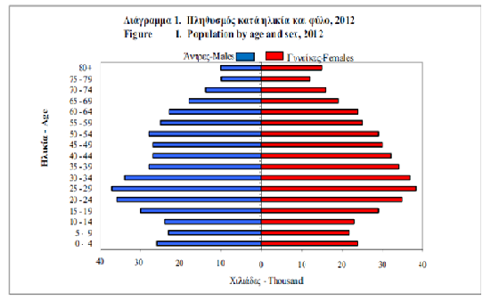
The Age Structure Pyramid
Statistical Service, 2012
Notes:
A basic figure that indicates the demographic trend in Cyprus and the ageing of the population is the age structure pyramid represented in this slide. This pyramid represent the age distribution and progress of population living in the Government controlled area of the Republic.
It is of importance to note that the proportion of children below 15 decreased to 16,4% while the proportion of old-aged persons 65 and over increased to 13,2% in 2012, compared to 25,4% and 11,0% respectively in 1992 and 25,0% and 10,8% in 1982.
The graph indicates that Cyprus is at the fourth stage of the Demographic Epidemiologic Transition Framework. The stage of delayed degenerative diseases and emerging infections

Slide 10
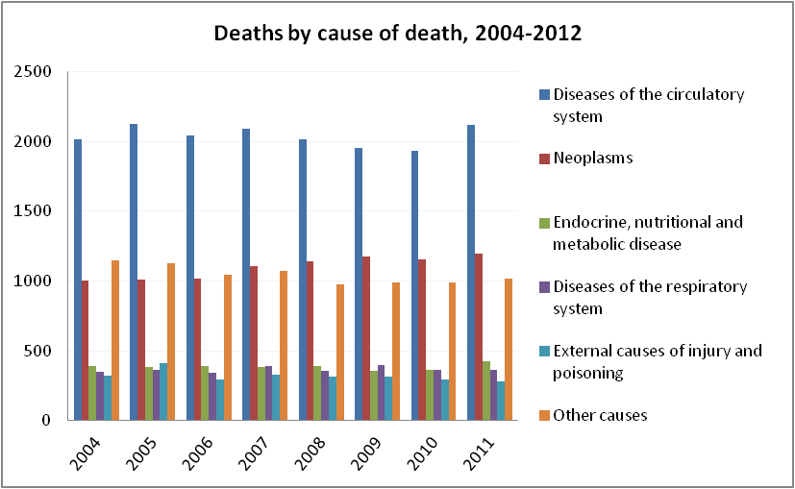
Causes of Death
Health Monitoring Unit, MOH, 2014
Notes:
This is well demonstrated by the statistical data on causes of death provided on this slide as well as the respective graph.
The main causes of Death are the Cardiovascular diseases (IHD and Cerebrovascular Accidents), the Neoplasms, the endocrine, the nutritional and metabolic diseases, the diseases of the respiratory system and injuries

Slide 11
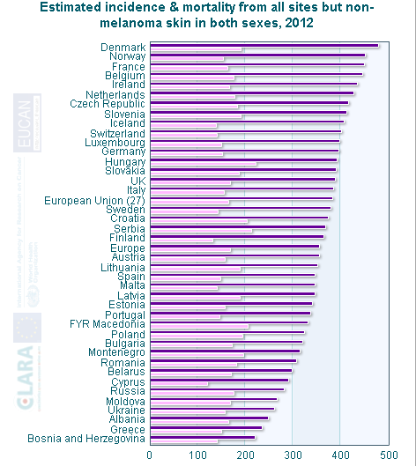
Cancer Incidence
Notes:
This graph provides information on cancer incidence data of Cyprus for both sexes, compared to those of a number of european countries.
It states that in 2012 the incidence was 290 compared to 382 of EU average and the mortality rate was 120, again well below 165 of EU-27 average. The lower than average incidence may be related to the favourable environmental conditions, the healthy Mediterranean diet as well as the lifestyle as well as the good socioeconomic status of the Cypriots.
The lower mortality rate may be attributed not only to the diagnosis of the disease at an early stage, but also to the high level of the health care for cancer patients that follows up to date protocols of provision of medicines, radiotherapy as well as follow up.

Slide 12
Health Indicators
Statistical Service, 2011
Notes:
When having an overall look at the indicators in the healthcare sector in Cyprus, this slide can be characterized as a representative one.
As it can be seen, Health Indicators compare favorably to those of the rest of the EU countries.
Lets see some of them in more detail

Slide 13
Infant Mortality
Notes:
Respectively, in 2012 Infant mortality rate in Cyprus was 3.5 compared to 3,8 average of EU 27 countries, highlighting the health and wellbeing of the population of Cyprus…

Slide 14
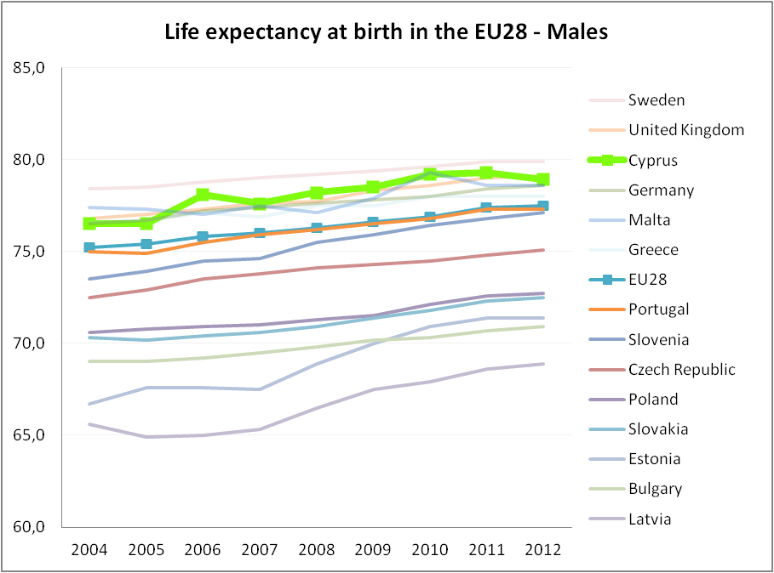
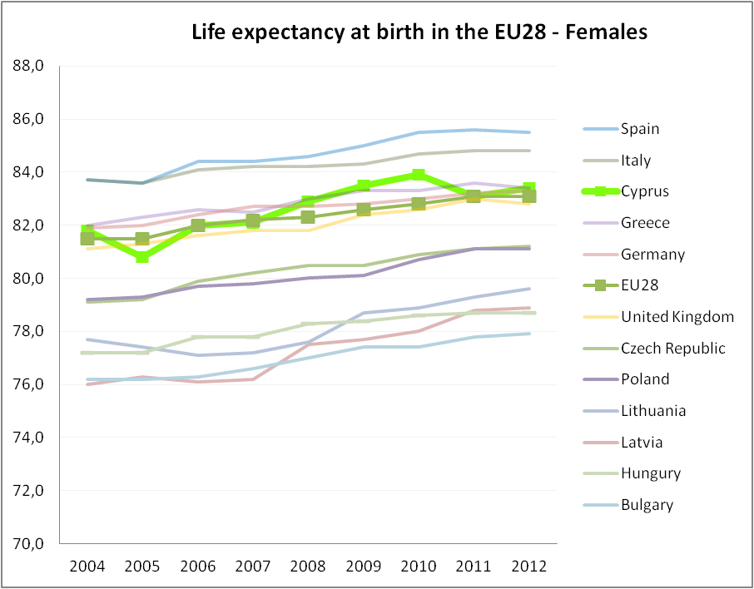
Life Expectancy
Notes:
…while, Life Expectancy at Birth for both sexes were relatively greater Compared to the mean EU rate in 2012.
As it can be seen the rate for males was 77,5 for EU28 and 78,9 for CY and the rate for Females was 83,1 for EU28 and 83,4 for CY.
This reflects not only the low levels of infant mortality but also a safe environment in which Cypriots live, a good health care system and the adoption of preventative health measures.

Slide 15
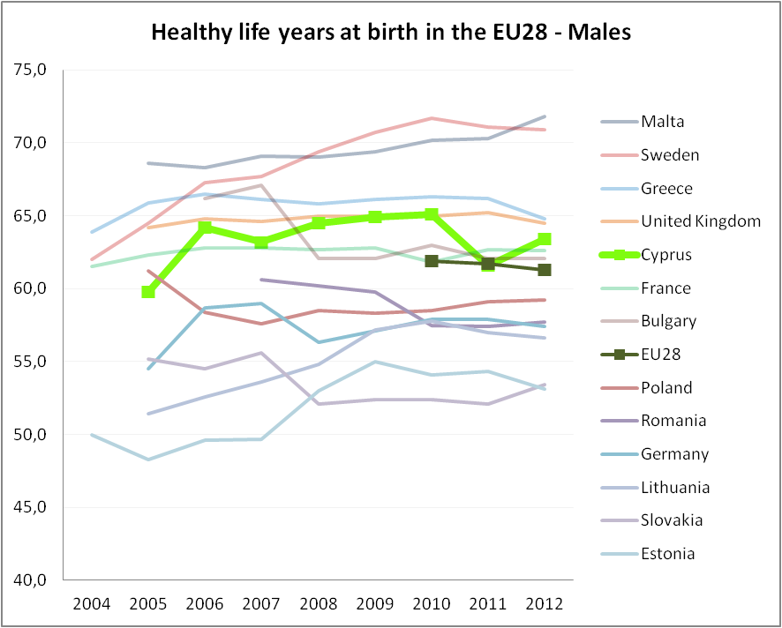
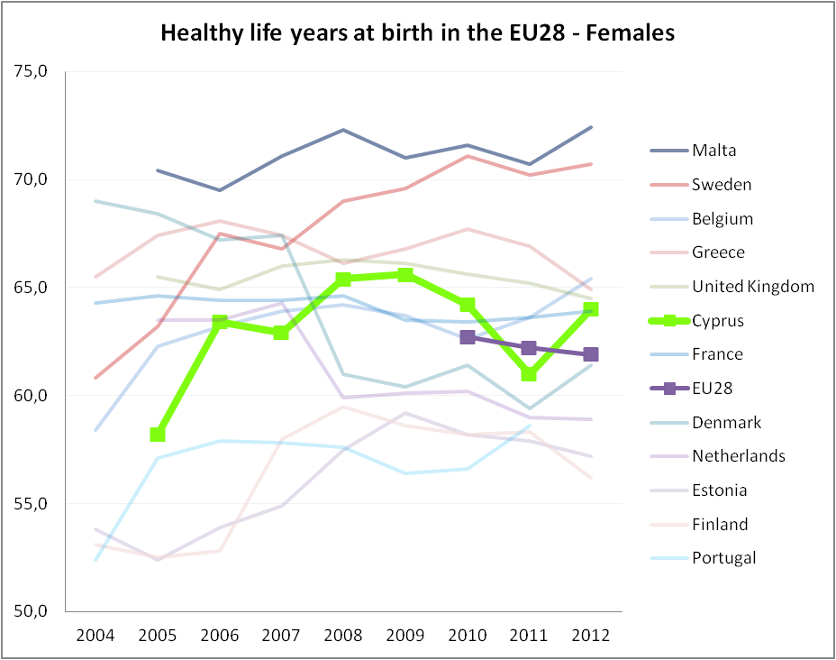
Healthy Life Years
Notes:
Not only Cypriots are expected to live longer than the European's average, but also enjoy more Healthy Life Years at birth, both in Males and Females.
Numbers state that during 2012 the rate for males in EU28 was 61.5 while in CY-63,4 and the rate for Females in EU28 was 61,9 while in CY- 64, again an indication of the high level of health care and the adoption of preventive measures.

Slide 16
C. Cyprus: Health System and the Current Reforms
Notes:
Keeping in mind these picture on the health status of the population in Cyprus, is wised mentioning or rather explaining , the structure of the Health System in Cyprus as well as its Current Reforms.

Slide 17
The current Health System
Two Parallel
Delivery Systems
Public Sector:
- services are provided by public hospitals and health centers,
- is financed from the government’s budget
- planning, administration and regulation is under the responsibility of the Ministry of Health.
Private sector:
- independent providers
-is financed mostly by out-of-pocket payments and by voluntary health insurance
- physician-owned facilities or private companies
Notes:
Cyprus is the only EU country without an NHS and the 2nd country after Greece with the widest social inequalities in the health sector, which boost the necessity for drastic reforms .
The current health system has two parallel delivery systems, the public and private sector.
The Ministry of Health is responsible for the planning, administration and regulation of the public sector that is financed from the government’s budget.
The private sector consists of independent providers, has facilities owned by physicians or private companies and is financed mostly by out of pocket payments and by voluntary health insurance

Slide 18
The Public Sector
Hospital Category | Number of Beds | Number of Staff | Staff per Hospital Bed
Nicosia General Hospital | 494 | 2164 | 4.38
Archbishop Makarios III Hospital | 154 | 661 | 4.29
Limassol general Hospital | 329 | 1178 | 3.58
Larnaca General Hospital | 167 | 710 | 4.25
Paphos General Hospital | 150 | 618 | 4.12
Famagusta General Hospital | 72 | 385 | 5.35
Rural Hospital of Kyperounta | 45 | 93 | 2.07
Rural Hospital of Polis Chrysochous | 11 | 71 | 6.45
Notes:
As regards to the Public Sector, the provision of services is performed by 7 main Hospitals, 38 Health Centers and 230 Health sub-centers for primary care, evenly distributed geographically, throughout the Country.
This table gives a general overview on the accommodation capacities and the staffing of the 7 main hospitals, which provide secondary and tertiary care.
The Nicosia General Hospital has a capacity of 494 beds, with a total number of 2164 staff (Doctors, Nurses/Midwives, Physiotherapists, Lab and Diagnosis Technicians, Administration and Financing Staff, Cleaning Staff, Kitchen Staff, Laundry Staff and others). From this total number of staff, the Doctors are 180 and the nurses/Midwifes 892.
The Makarios Hospital has a capacity of 154 beds, with a total number of 661 staff (Doctors, Nurses/Midwives, Physiotherapists, Lab and Diagnosis Technicians, Administration and Financing Staff, Cleaning Staff, Kitchen Staff, Laundry Staff and others). From this total number of staff, the Doctors are 72 and the nurses/Midwifes 347.
The Limassol General Hospital has a capacity of 329 beds, with a total number of 661 staff (Doctors, Nurses/Midwives, Physiotherapists, Lab and Diagnosis Technicians, Administration and Financing Staff, Cleaning Staff, Kitchen Staff, Laundry Staff and others). From this total number of staff, the Doctors are 120 and the nurses/Midwifes 566.
The Larnaca General Hospital has a capacity of 167 beds, with a total number of 710 staff (Doctors, Nurses/Midwives, Physiotherapists, Lab and Diagnosis Technicians, Administration and Financing Staff, Cleaning Staff, Kitchen Staff, Laundry Staff and others). From this total number of staff, the Doctors are 88 and the nurses/Midwifes 335.
The Paphos General Hospital has a capacity of 150 beds, with a total number of 618 staff (Doctors, Nurses/Midwives, Physiotherapists, Lab and Diagnosis Technicians, Administration and Financing Staff, Cleaning Staff, Kitchen Staff, Laundry Staff and others). From this total number of staff, the Doctors are 68 and the nurses/Midwifes 250.
The Famagusta General Hospital has a capacity of 72 beds, with a total number of 385 staff (Doctors, Nurses/Midwives, Physiotherapists, Lab and Diagnosis Technicians, Administration and Financing Staff, Cleaning Staff, Kitchen Staff, Laundry Staff and others). From this total number of staff, the Doctors are 39 and the nurses/Midwifes 160.
The Rural Hospital of Kyperounta has a capacity of 45 beds, with a total number of 93 staff (Doctors, Nurses/Midwives, Physiotherapists, Lab and Diagnosis Technicians, Administration and Financing Staff, Cleaning Staff, Kitchen Staff, Laundry Staff and others). From this total number of staff, the Doctors are 10 and the nurses/Midwifes 35.
The Rural Hospital of Polis Chrysochous has a capacity of 11 beds, with a total number of 71 staff (Doctors, Nurses/Midwives, Physiotherapists, Lab and Diagnosis Technicians, Administration and Financing Staff, Cleaning Staff, Kitchen Staff, Laundry Staff and others). From this total number of staff, the Doctors are 11 and the nurses/Midwifes 34.

Slide 19
The Private Sector
Hospital Category* | No of. Hospitals | No. of Beds | No. of Nursing Staff | No. Of Midwifes | No of assistant staff
Hospitals | 18 | 833 | 613 | 36 | 61
Polyclinics | 16 | 256 | 159 | 6 | 12
Clinics | 20 | 216 | 142 | 19 | 12
Daily Care | 19 | 88 | 39 | 1 | 4
Total | 73 | 1393 | 953 | 62 | 89
* The Hospital category is defined in the Legislation based on specific set criteria
Notes:
As regards to private sector, services are provided by private Hospitals, Policlinics, Clinics and Daily Cares, established and operating in the five districts of the Country in accordance to the National Legislation on Private Hospitals (Establishment and Control) Law. They are all 73 in total and have 1393 beds

Slide 20
Public health expenditure is 43% of the total health expenditure, one of the three lowest percentages in the EU*
6,9% of public expenditure is dedicated to healthcare, a percentage also very low in relation to EU average which is 15,8% **
49,4% of health expenditure comes from Out-Of-Pocket expenditure, while EU average is as low as 14% ***
At the same time
Public budget is pushed by increased demand in the public sector, whereas the economic crisis intensifies the problems with negative consequences on the population.
* OECD Health data 2013 and GoC State Budget, W.B. Functional Report, March 2014.
** World Development Indicators October 2013 (2011 data), W.B. Functional Report, March 2014.
*** World Development Indicators October 2013 (2011 data), W.B. Functional Report, March 2014.
Notes:
It shall be noted that the percentages of public health expenditure as well as the increased demand in public health services, pushes the healthcare system and these act as a prerequisite for the emerge of healthcare reforms.
Public health expenditure is 43% of the total health expenditure, one of the three lowest percentages in the EU
6,9% of public expenditure is dedicated to healthcare, a percentage also very low in relation to EU average which is 15,8%
49,4% of health expenditure comes from Out-Of-Pocket expenditure, while EU average is as low as 14%
While, at the same time
Public budget is pushed by increased demand in the public sector, whereas the economic crisis intensifies the problems with negative consequences on the population.

Slide 21
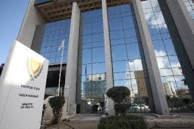
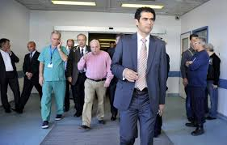
The Ministry of Health
Notes:
These characteristics of the current health system of the Country, indicates the necessity for reforms to be urgently implemented.
For this reason, the Ministry of Health, as the responsible competent authority, in July 2014 has embarked in a Reform Program that will modernize, rationalize and improve further the quality of Cyprus’ health care delivery, create the conditions for equitable access and the sustainability of its financing, and modernize its governance.
The required structural reforms will address the whole health sector, including both its public and private components, highlighting he role of the Ministry of Health as a national health policy formulator, health care standards regulator and supervisor of the enforcement of the relevant legislation, while meeting Troika MOU requirements for timely and effective implementation.

Slide 22
Mission: To assure a people-oriented health system for the country, which emphasizes on prevention and aims at strengthening the social responsibility through the continuous improvement of the provided services with professionalism and respect to all citizens, on an equal basis.
Vision: Quality healthcare services to all citizens throughout the whole period of their lives.
Values: Social Responsibility, Equality in Health, Quality in Health, Improvement of the quality of life with emphasis on prevention, Excellence, Integrity, Efficiency, Professionalism, Respect and Teamwork
Notes:
Under my capacity as the Minister of Health, I find it essential and very crucial to move forward based on a strategic plan, which will include specific vision, mission, values, strategic goals and activities.
For this reason, we have already started work into the development of a comprehensive strategy for the years 2014-2018, which will include the followings:
Mission: To assure a people-oriented health system for the country, which emphasizes on prevention and aims at strengthening the social responsibility through the continuous improvement of the provided services with professionalism and respect to all citizens, on an equal basis.
Vision: Quality healthcare services to all citizens throughout the whole period of their lives.
Values: Social Responsibility, Equality in Health, Quality in Health, Improvement of the quality of life with emphasis on prevention, Excellence, Integrity, Efficiency, Professionalism, Respect and Teamwork

Slide 23
Strategic Goals:
Restructuring of the Health System of the Country,
eHealth upgrade and support,
Enhancement and enrichment of the active and efficient presentation to the European and International environment,
Strengthening of prevention and promotion of health throughout the lifecycle,
Management, training and development of human recourses in the health sector,
Scientific Excellence
Notes:
Strategic Goals:
Restructuring of the Health System if the Country,
eHealth upgrade and support,
Enhancement and enrichment of the active and efficient presentation to the European and International environment,
Strengthening of prevention and promotion of health throughout the lifecycle,
Management, training and development of human recourses in the health sector,
Scientific Excellence

Slide 24
Restructuring the Health System
Notes:
As mentioned before, a great task to be urgently completed is the restructuring of the current health system of the country.
This is going to be achieved through seven pillars

Slide 25
Seven pillars of the Health System Reforms
Introduction of a National Healthcare System (NHS)
Autonomization & Restructuring of Public Hospitals and Public Health Facilities (Primary Healthcare Centres)
Strengthening and upgrading E-Health
Restructuring of the Ministry of Health
Restructuring of associated organisations
Reforms on Pharmaceutical
Review of the legislation
Notes:
The seven pillars of the Health System Reforms are
Introduction of a National Healthcare System (NHS)
Autonomization & Restructuring of Public Hospitals and Public Health Facilities (Primary Healthcare Centres)
Strengthening and upgrading E-Health
Restructuring of the Ministry of Health
Restructuring of associated organisations
Reforms on Pharmaceutical
Review of the legislation

Slide 26
I. Introduction of a National Healthcare System (NHS)
To be implemented within specific timeframes (partial implementation by mid-2015, full implementation by mid-2016)
Basic principles:
Universal coverage for all citizens.
Fair distribution of cost and solidarity, in terms of support to socially vulnerable groups.
Free choice of Doctor and healthcare Provider by the citizens, creating simultaneously a healthier competitive environment in the healthcare sector.
Financial sustainability.
Removal of separation between Public and Private Health services.
Notes:
The first pillar is the introduction of a National Healthcare System (NHS)
The NHS is to be implemented within specific timeframes (partial implementation by mid-2015, full implementation by mid-2016), based on the following basic principles:
Universal coverage for all citizens.
Fair distribution of cost and solidarity, in terms of support to socially vulnerable groups.
Free choice of Doctor and healthcare Provider by the citizens, creating simultaneously a healthier competitive environment in the healthcare sector.
Financial sustainability
It is quite sure that the completion of such a task will remove the separation between Public and Private Health services providers .

Slide 27
II. Autonomization & Restructuring of Public Hospitals and Public Health Facilities (Primary Healthcare Centres)
A prerequisite for the viable operation of the NHS.
Evolution of hospitals into modern, independent state-owned legal entities with legal, financial, management and scientific autonomy.
Introduction of executive management teams in hospitals.
Each hospital to manage its human and other resources in an efficient way.
15 million euros have been secured from EU Structural Funds to transform them, within three years, into “paperless hospitals”.
Notes:
The second pillar of the health systems reform is the Autonomization & Restructuring of Public Hospitals and Public Health Facilities (Primary Healthcare Centres)
This reform is essential for the following reasons:
A prerequisite for the viable operation of National Health System
Evolution of hospitals into modern, independent state-owned legal entities with legal, financial, management and scientific autonomy
Introduction of executive management teams in hospitals
Each hospital to manage its human and other resources in an efficient way
15 million euros have been secured from EU Structural Funds to transform them, within three years, into “paperless hospitals”

Slide 28
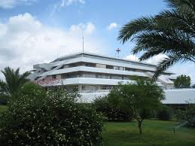
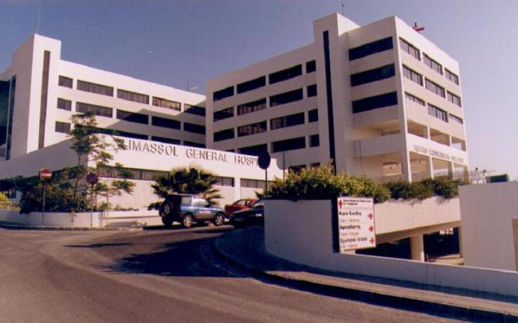
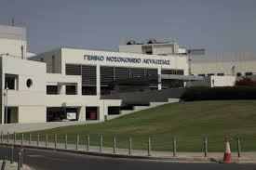
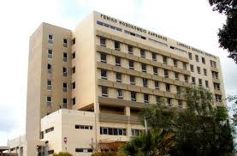
Public Sector Health Care Facilities
.
Notes:
This is just a slide presenting some of the major public health hospitals, evenly distributed geographically throughout the County’s districts.

Slide 29
Capacity building:
Implementation of Integrated, Health Information System to all Public Health Facilities,
Setting up IT infrastructure for NHS,
35 m. Euros from structural funds
Promotion and strengthening of
e-health in favour of the providers as well as the patients.
Upgrading of e-Health services.
III. Strengthening and upgrading e-Health
Notes:
The third pillar refers to strengthening and upgrading e-Health. Specifically
Information Technology Capacity building, by
Implementation of Integrated Health Information System to all Public Health Facilities
Setting up IT infrastructure for NHS
A total amount of 35 m. Euros has been secured for this from EU structural funds
Promotion and strengthening of e-health, in favour of the providers as well as the patients
3. Upgrading of e-Health services

Slide 30
IV. Restructuring of the Ministry of Health
Swift to a new , modern organisation.
Simplification of procedures.
Efficiency of Results.
Establishment of an organizational structure able to respond to the needs of the new healthcare system featuring the implementation of NHS and the autonomization of public hospitals and other public health facilities.
Notes:
The fourth pillar is the Restructuring of the Ministry of Health so as to be able to Swift to a new , modern organisation, to simplify its procedures and achieve efficiency of Results.
Most of all, it is important to mention that this reform is required for establishing an organizational structure which will be able to respond to the needs of the new healthcare system featuring the implementation of NHS and the autonomization of public hospitals and other public health facilities.

Slide 31
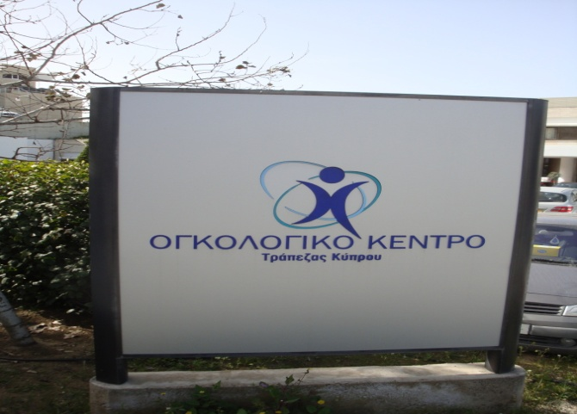
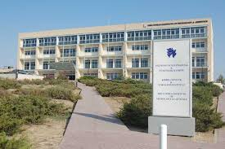
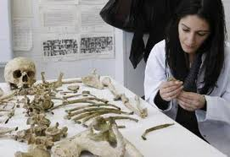
V. Restructuring of the MoH associated organisations
Notes:
As regards to the restructuring of associated organizations, this is also required for being able to respond better to the needs of the market after the introduction of the NHS, the autonomization of Public hospitals and the restructuring of the Ministry of Health.
The Cyprus Institute of Neurology and Genetics and the Bank of Cyprus Oncology Centre are two organizations associated to the Ministry of Health and centers of excellence. The first Specialized Health Care Services, Research and Tertiary level training in the area of Neurology and Genetics and the second Specialized Health Care Services in the area of Oncology.

Slide 32
VI. Reforms on Pharmaceutical
Establishment of a strategy for downward adjustment of prices.
Establishment of an MEA unit at the Pharmaceutical Services and build capacity in corresponding aspects.
Development and implementation of a strategy for the establishment of an HTA unit.
Notes:
The sixth pillar refers to reforms on Pharmaceuticals relating mainly to the establishment of a strategy for downward adjustment of prices, establishment of an Managed Entry Agreement (MEA) unit at the Pharmaceutical Services and build capacity in the corresponding aspect as well as the development and implementation of a strategy for the establishment of an Health Technology Assessment (HTA) unit

Slide 33
VII. Review of the legislation
Role of the Ministry of Health as Regulator and supervisor of the enforcement of the relevant legislation.
Need to review existing Laws and Regulations related to the practise of health professionals, running of health facilities, laboratories etc.
Notes:
As I have said already reforms will be highlighting among other the role of the Ministry of Health as a health care standards regulator and supervisor of the enforcement of the relevant legislation.
There is need to review existing Laws and Regulations related to the practise of health professionals, running of health facilities, laboratories etc

Slide 34
D. Cyprus: Global Health Perspective
Notes:
Cyprus, through years managed to conquer a positive position in the International Scene, with policies aiming among others at the development of the sciences and relationships to the benefit of the citizens.

Slide 35
International Relations:
Cyprus is a Member of key development partners involved in global health, including WHO-European Region and the rest United Nations Agencies, the European Union and the Council of Europe
Also, Cyprus participates in global health programmes, partnerships and commissions, e.g. Codex Alimentarius- International Food Standards Programme established by FAO and WHO, the Global Fund to fight AIDS, Tuberculosis and Malaria, the Commission on Narcodic Drugs (CND) e.t.c.
Cyprus role in Global Health was also highlighted during the Cyprus Presidency of the Council of the EU, when various events were held aiming at the promotion of health and the prevention of diseases both at EU and International level.
Notes:
As regards specifically to the Healthcare sector, the Ministry of Health has established relationships with key health development partners involved in global health, including WHO-European Region and the rest United Nations Agencies, the European Union, the Council of Europe
It also participates in global health programmes, partnerships and commissions, e.g. Codex Alimentarius- International Food Standards Programme established by FAO and WHO, the Global Fund to fight AIDS, Tuberculosis and Malaria, the Commission on Narcodic Drugs (CND) e.t.c.
Additionally, the Cyprus role in Global Health was highlighted during the Cyprus Presidency of the Council of the EU, various events were held aiming at the promotion of health and the prevention of diseases not only at EU but also International level.

Slide 36
Collaboration with Russia
Through years the Republic of Cyprus entered into collaboration Agreements and Memorandum of Understandings in the area of health and medical science with various partnering countries, including Russia back in 2008.
In 2013 a Protocol for Cooperation between Cyprus and Russia was signed , in the framework of the 7th Conference of the Cyprus-Russia Intergovernmental Committee for Economic Cooperation.
The Common Action Plan for Health 2014-2017 between Cyprus and Russia is under negotiations and will include specific provisions for sending students to Cyprus and Russia for Medical and Paramedical studies, exchange of experiences and knowledge on medical tourism, processing of common research programmes in the area of health and medical science e.t.c
Notes:
In the area of intergovernmental collaboration, needless to mention the strong relationships of Cyprus with Russia.
Specifically, as regards to the Healthcare sector, the strong collaboration between the two countries is undeniable, but I would like to take just a small part of your time today mentioning that:
Through years the Republic of Cyprus entered into collaboration Agreements and Memorandum of Understandings in the area of health and medical science with various partnering countries, including Russia back in 2008.
In 2013 a Protocol for Cooperation between Cyprus and Russia was signed , in the framework of the 7th Conference of the Cyprus-Russia Intergovernmental Committee for Economic Cooperation.
The Common Action Plan for Health 2014-2017 between Cyprus and Russia is under negotiations and will include specific provisions for sending students to Cyprus and Russia for Medical and Paramedical studies, exchange of experiences and knowledge on medical tourism, processing of common research programmes in the area of health and medical science e.t.c

Slide 37
E. Cyprus: An International Medical Tourism Destination
Notes:
Cyprus includes the promotion of Medical Tourism high on the agenda, being able to provide qualitative healthcare services even to the most demanding travelers.
Through the following slides, Cyprus is represented to you as an International Medical Tourism Destination, based on specific Characteristics which in some cases consist competitive advantages

Slide 38
Services relatively Affordable
Services easily Accessible
Availability and Acceptability of all types of Services
Services with an Added Value
5A Factors Destination
Notes:
A great characteristic of Cyprus is that it combines all 5 A Factors, which are the basic actors involved in the decision making process of Medical Tourism.
By this mean, Services are relatively Affordable and easily Accessible. There is Availability and Acceptability of all types of Services and the services provided have an Added value.

Slide 39
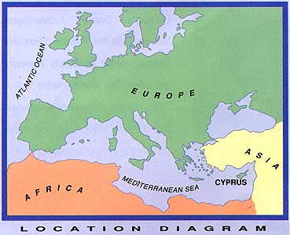
The Strategic Geographic position of Cyprus, being at the cross road of Europe, Asia and Africa, guarantee the easy access to the Country and the travelling to neighbouring countries.
Geographic Position
Notes:
Cyprus Strategic Geographic position at the cross road of Europe, Asia and Africa, guarantee the easy access to the Country and the travelling to neighbouring countries.

Slide 40
Healthy Climate (sun, sea) in combination with available tourism facilities, makes it a destination for health and vacation.
There is a great number of Russian nationals who live permanently in Cyprus as well Russian Speaking people.
Combining Health with Vacation
Notes:
The Healthy Climate (sun, sea) of Cyprus, in combination with the available tourism facilities, makes it a destination for health and vacation.
The great number of Russian nationals who live permanently in Cyprus as well Russian Speaking people is an additional reason to select Cyprus as a combined destination for medical and vacation reasons.

Slide 41
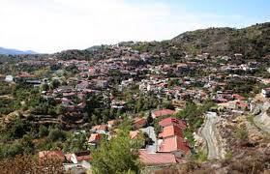
Environmental conditions that affect positively the health of the population
(e.g. the case of Kyperounta area with the perfect climate for respiratory problems)
Healthy Environmental Conditions
Notes:
Environmental conditions affect positively the health of the population. An example is Kyperounta, a village in an altitude of 1340 m with the perfect conditions to alleviate respiratory problems.

Slide 42
The physical characteristics of the soil, enables the production of fruits and foodstaff, consisting by healthy ingredients.
These products are part of the Mediterranean diet (olives, oil, fresh fish, vegetables, fruits), well known for its benefits to health by reducing the risk factors.
Source of Healthy Eating
Notes:
An other advantage of Cyprus in the tourist and health arena is being the source of healthy eating.
The physical characteristics of the soil, enables the production of fruits and foodstaff, with healthy ingredients
These products are part of the Mediterranean diet (olives, oil, fresh fish, vegetables), which is well known for its healthy status.

Slide 43
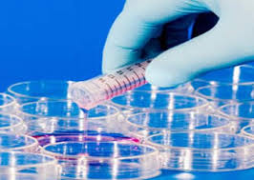
Is a country with strong historic relations in medical science, being turned into a human philosophy.
So far, Doctors were trained in Universities and Medical Centres abroad, enabling them a high level of education and strong relationships with health professionals abroad.
A great number of well recognised health scientists and researchers, with tremendous contribution in medical sciences.
Advanced Medical Science
Notes:
Cyprus is a country with strong historic relations in medical science, being turned into a human philosophy. So far, Doctors were trained in Universities and Medical Centres abroad, enabling them a high level of education and strong relationships with health professionals abroad. There is a great number of well recognised health scientists and researchers, with tremendous contribution in medical sciences. Needless to say that a number of Medical Professionals qualified from Russian Universities

Slide 44
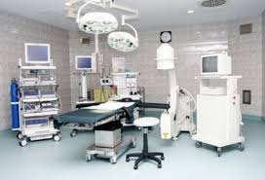
Is a “value for Money” destination, with relatively low cost of provided healthcare services in combination with their high quality.
Existence of Centres of International Excellence and Centres of Reference, e.g. the Cyprus Institute of Neurology and Genetics
Improved healthcare facilities and medical equipment.
Quicker access to the necessary treatment.
Negative relation “Cost - Quality”
Notes:
In addition to these characteristics, Cyprus can be considered as a Country with a negative relationship between cost and quality. This negative sign is translated into a positive effect to health and can be explained by the fact that Cyprus:
Is a “value for Money” destination, with relatively low cost of provided healthcare services in combination with their high quality.
Existence of Centres of International Excellence and Centres of Reference, e.g. the Cyprus Institute of Neurology and Genetics
Improved healthcare facilities and medical equipment
Quicker access to the necessary treatment.

Slide 45
F. Cyprus: Prospects and Opportunities for Medical Investments
Notes:
Investing in medical infrastructure and provision of specialized healthcare services in Cyprus is fully welcomed.
For this reason, there are specific prospects and opportunities in this area, that I will try to briefly mention in my following slides.

Slide 46
The investment environment
Governmental Policy :
Measures taken to enhance Cyprus competitiveness,
Measures for promoting investments in Cyprus, including the healthcare sector (Council of Ministers Decision for the issue of Cypriot Citizenship in case of investment of at least € 5,0 million for the purchase or construction of buildings or for the construction of other land development projects and the issue of Permanent Immigration Permit when purchasing a property at least € 300,000).
Legal Framework (equitable and fair treatment to foreign investors).
Taxation (offering a range of alternative tax advantages to foreign companies conducting business on the island)
Notes:
Let me introduce this chapter by mentioning some characteristics of Cyprus as an advantageous investment destination, based on the information provided by the Cyprus Investment Promotion Agency.
Governmental Policy :
Measures taken to enhance Cyprus competitiveness,
Measures for promoting investments in Cyprus, including the healthcare sector (Council of Ministers Decision for the issue of Cypriot Citizenship in case of investment of at least € 5,0 million for the purchase or construction of buildings or for the construction of other land development projects and the issue of Permanent Immigration Permit when purchasing a property at least € 300,000). More info on this can be found in the website of the Ministry of Interior at www.moi.gov.cy as “SCHEME FOR NATURALISATION OF INVESTORS IN CYPRUS BY EXCEPTION”
Legal Framework (Cyprus’ legislation guarantees an equitable and fair treatment to foreign investors).
Taxation (Cyprus offers a range of alternative tax advantages to foreign companies conducting business on the island, including uniform corporate tax rate in the E.U., double taxation treaties with over 40 countries)

Slide 47
Investment areas in Healthcare
Great demand for Rehabilitation Services
Opportunity for establishing alcohol detoxification Centres
Need for Medical Care Centres
Notes:
Cyprus geographic position, excellent climate and affordable luxurious hotel facilities provide an excellent opportunity for investments for rehabilitation as well as detoxification or other specialised centers for chronically ill patients to accommodate the need of the whole Eastern Mediterranean Region.
Also in view of the current reforms, establishing medical care centers are an excellent opportunity for investment

Slide 48
Contact Details:
Ministry of Health:
Permanent Secretary
Tel: 00357 22 605300/301
E-mail: perm.sec@moh.gov.cy,
www.moh.gov.cy
Cyprus Health Services Promotion Board:
Mr. Polis Georghiades
President of CHSPB
Tel. 00357 99664 888 & 00357 22889890
E-mail: cyprushealth@ccci.org.cy ,
www.cyhealthservices.com
Cyprus Investment Promotion Agency (CIPA)
Mr. Charis Papacharalambous (Director General)
Phone: +357 22 441133
Email: cpapacharalambous@investcyprus.org.cy, info@investcyprus.org.cy,
www.investcyprus.org.cy
Notes:
By closing my presentation I would like to provide you with some basic contacts in regards to medical tourism activities and opportunities in Cyprus, as follows:
Ministry of Health:
Permanent Secretary
Tel: 00357 22 605300/301
E-mail: perm.sec@moh.gov.cy,
www.moh.gov.cy
Cyprus Health Services Promotion Board:
Mr. Polis Georghiades
President of CHSPB
Tel. 00357 99664 888 & 00357 22889890
E-mail: cyprushealth@ccci.org.cy ,
www.cyhealthservices.com
Cyprus Investment Promotion Agency (CIPA)
Mr. Charis Papacharalambous (Director General)
Phone: +357 22 441133
Email: cpapacharalambous@investcyprus.org.cy, info@investcyprus.org.cy,
www.investcyprus.org.cy

Slide 49
Thank you for your attention !
Notes:
Dear friends,
Over the last half an hour I have tried to provide you a glimpse on Cyprus as a medical tourism destination.
I expect that I have succeeded
Thank you for your attention.

